Slide 1
fluo tubes in chamber 20 (mixed chamber; top shelf)

Slide 2
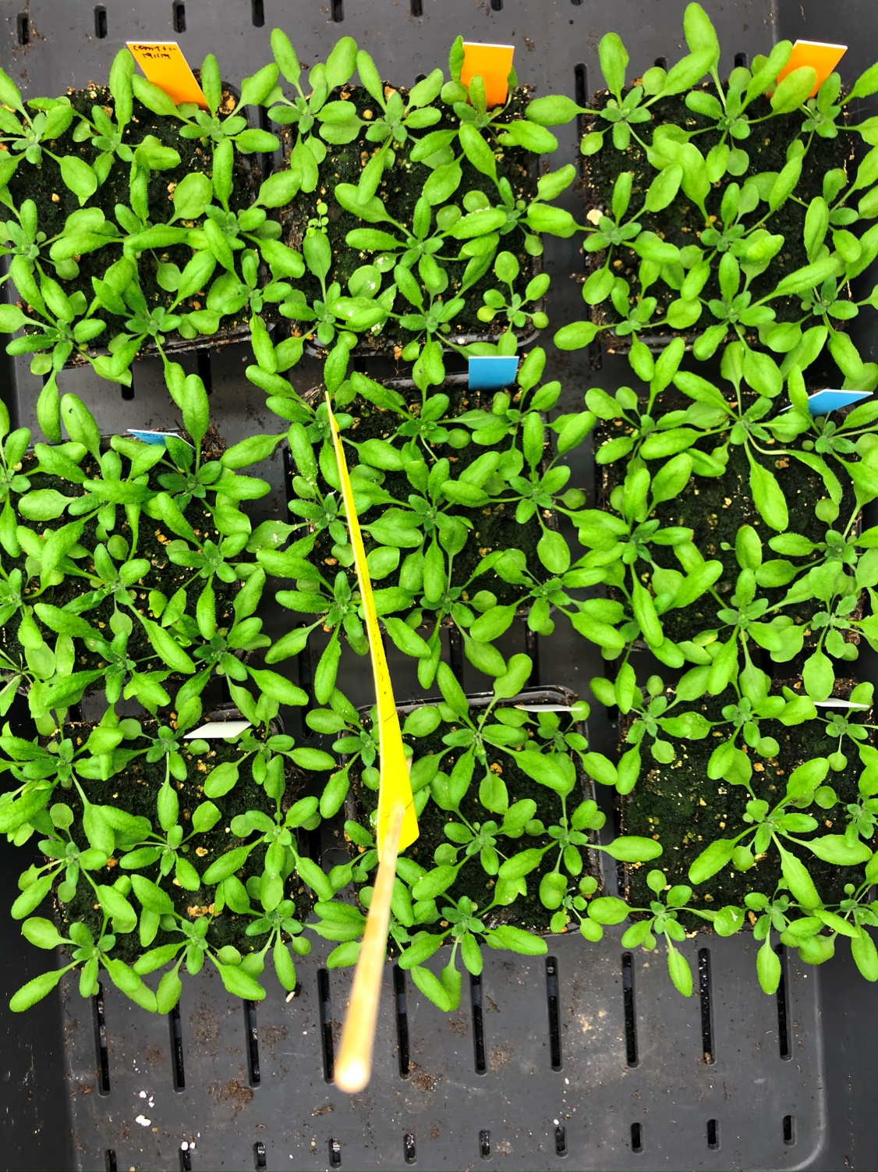
21DAS; Gramoflor no fertilizer

Slide 3
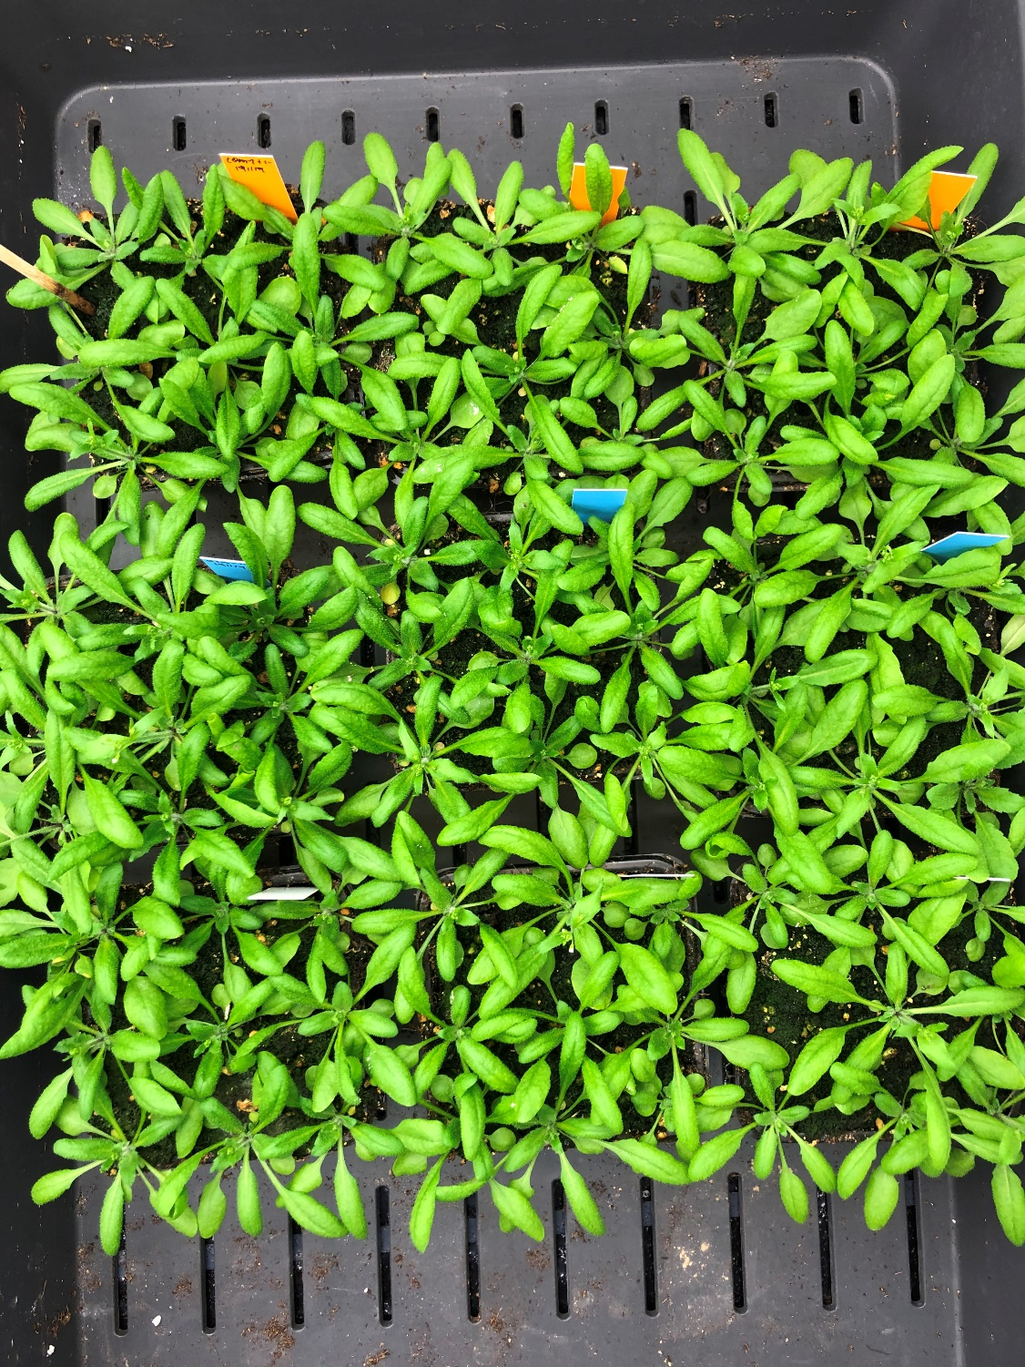
24DAS; Gramoflor no fertilizer

Slide 4
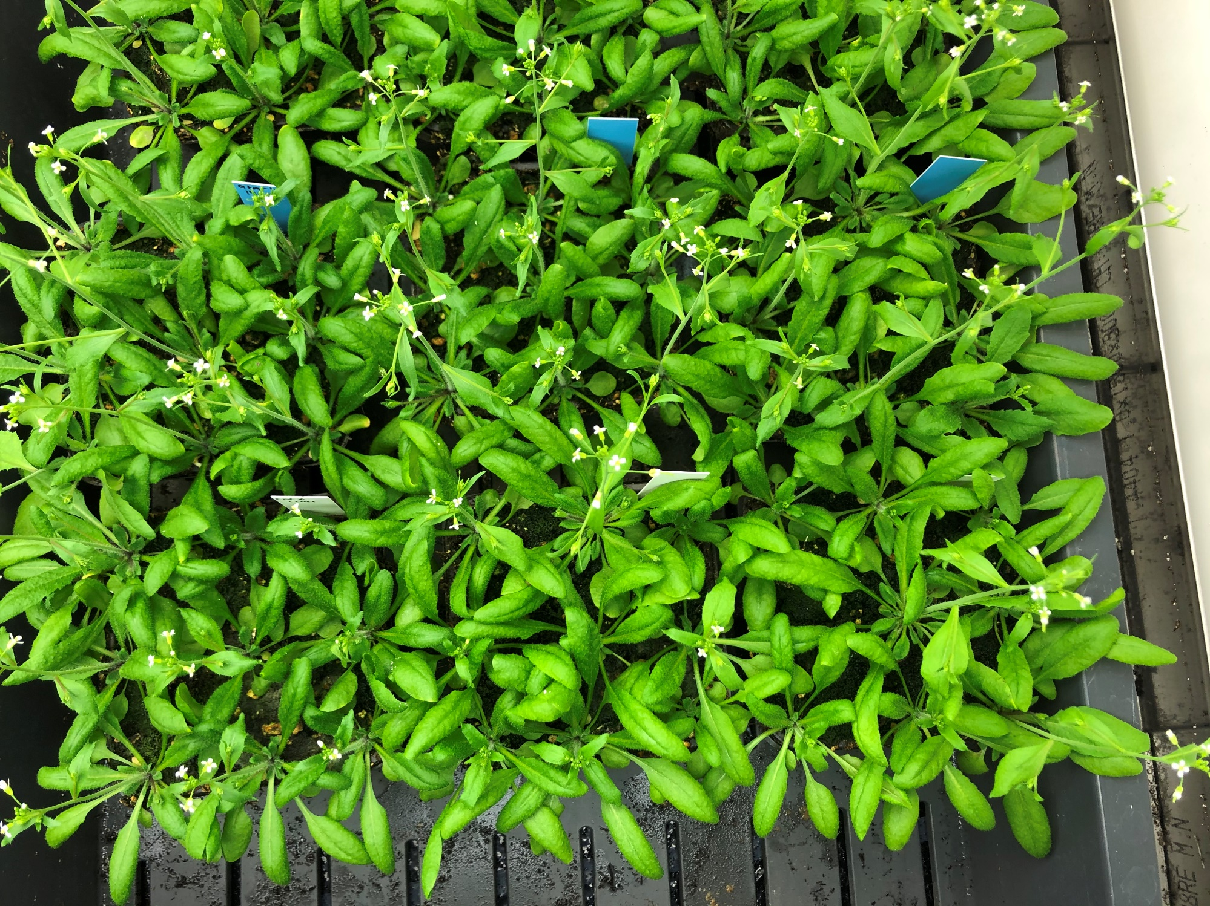
27DAS; Gramoflor no fertilizer

Slide 5
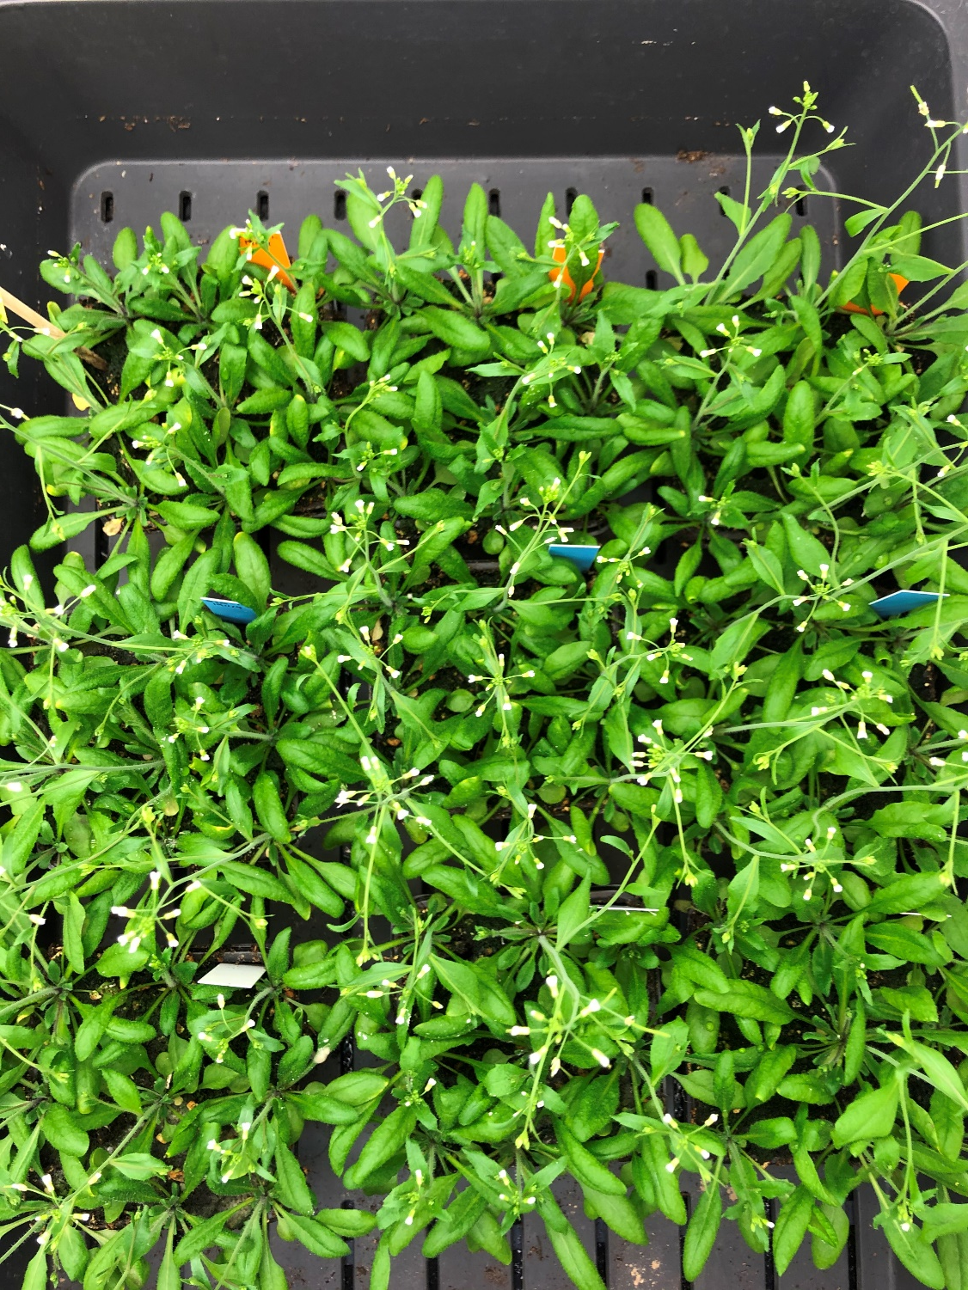
28DAS; Gramoflor no fertilizer

Slide 6
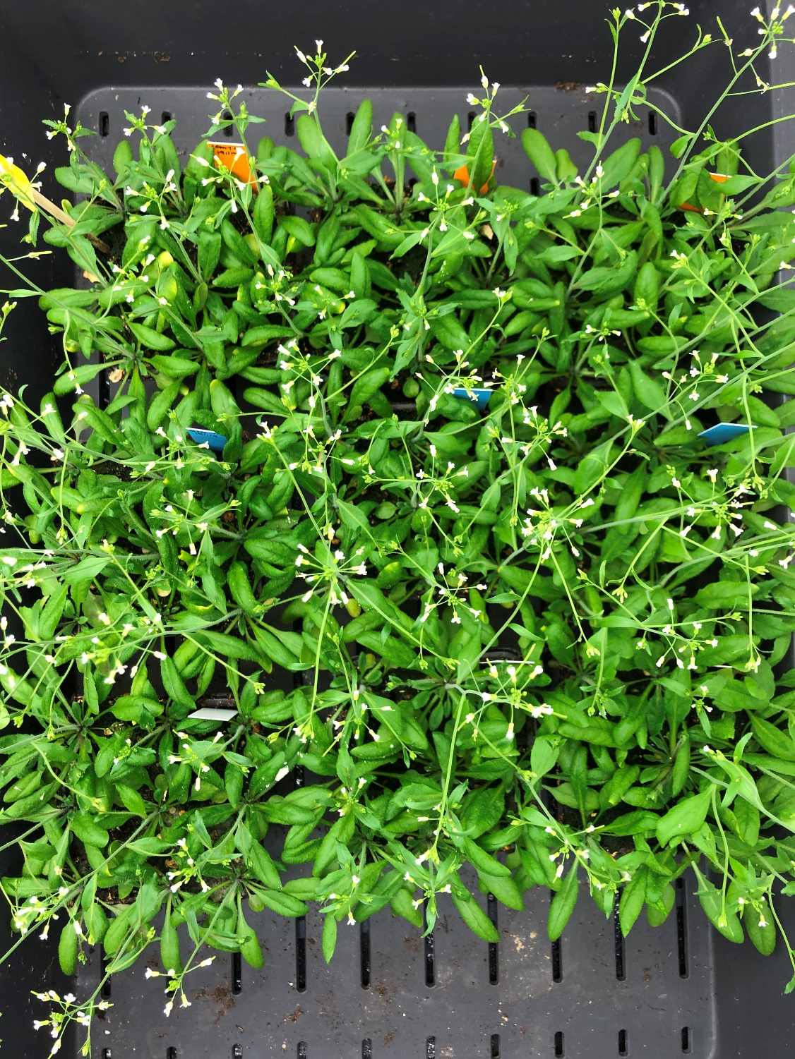
29DAS; Gramoflor no fertilizer

Slide 7
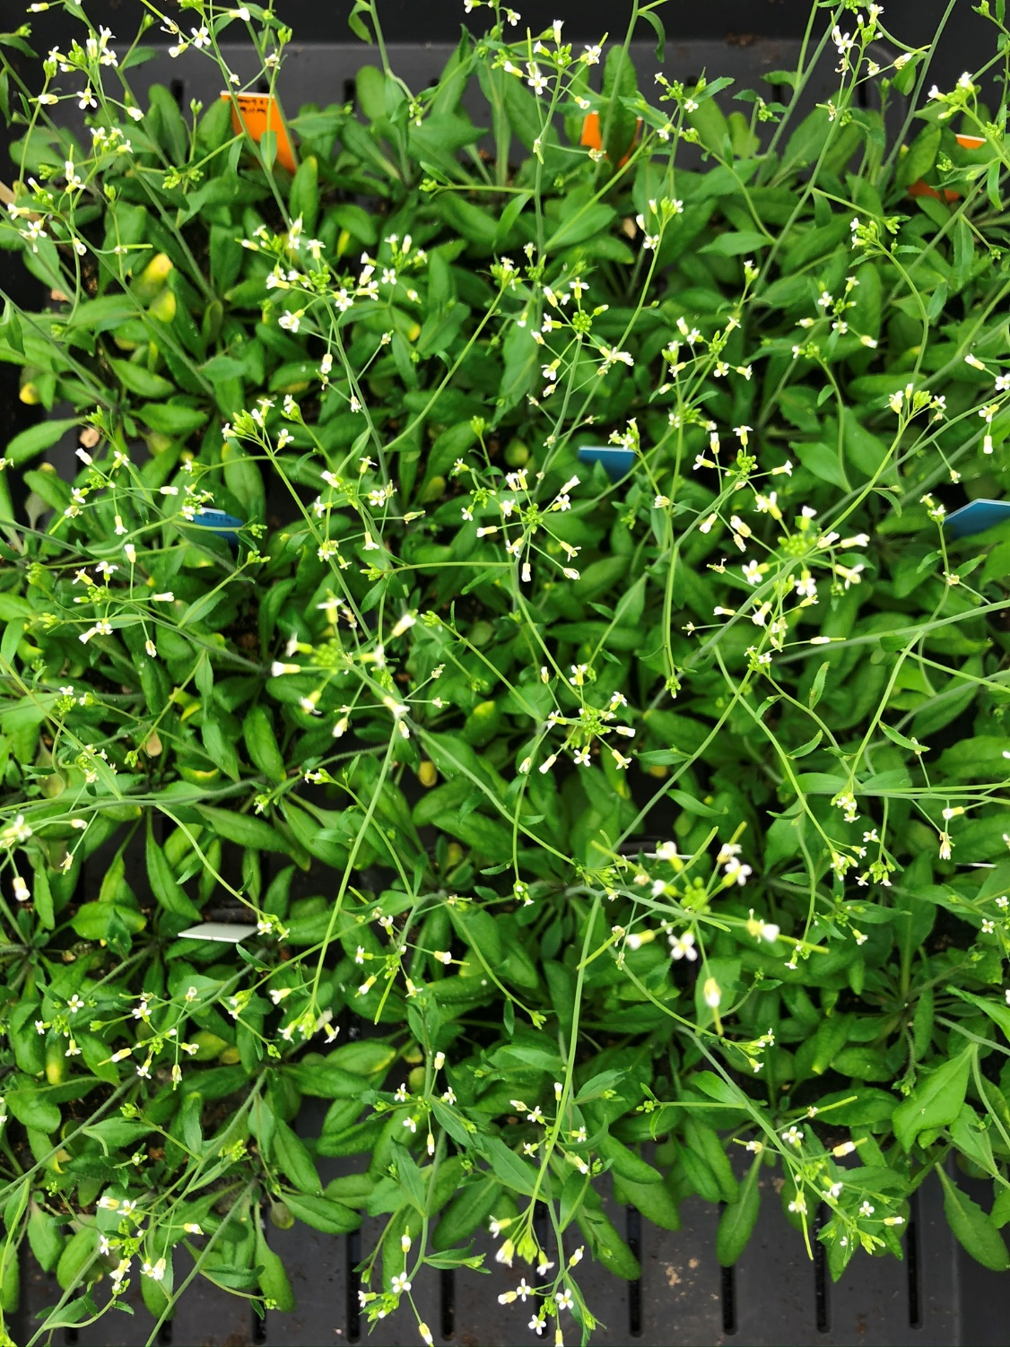
30DAS; Gramoflor no fertilizer

Slide 8
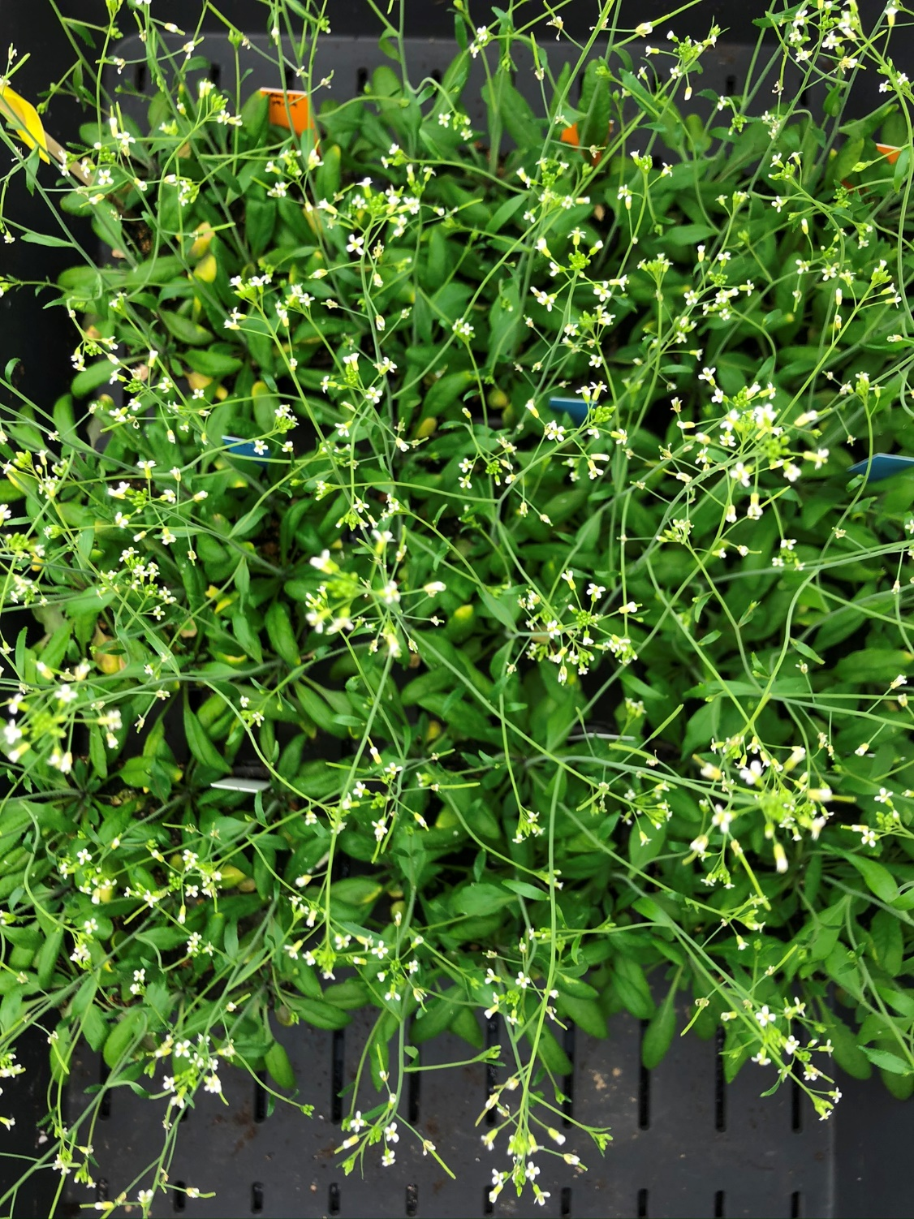
31DAS; Gramoflor no fertilizer

Slide 9
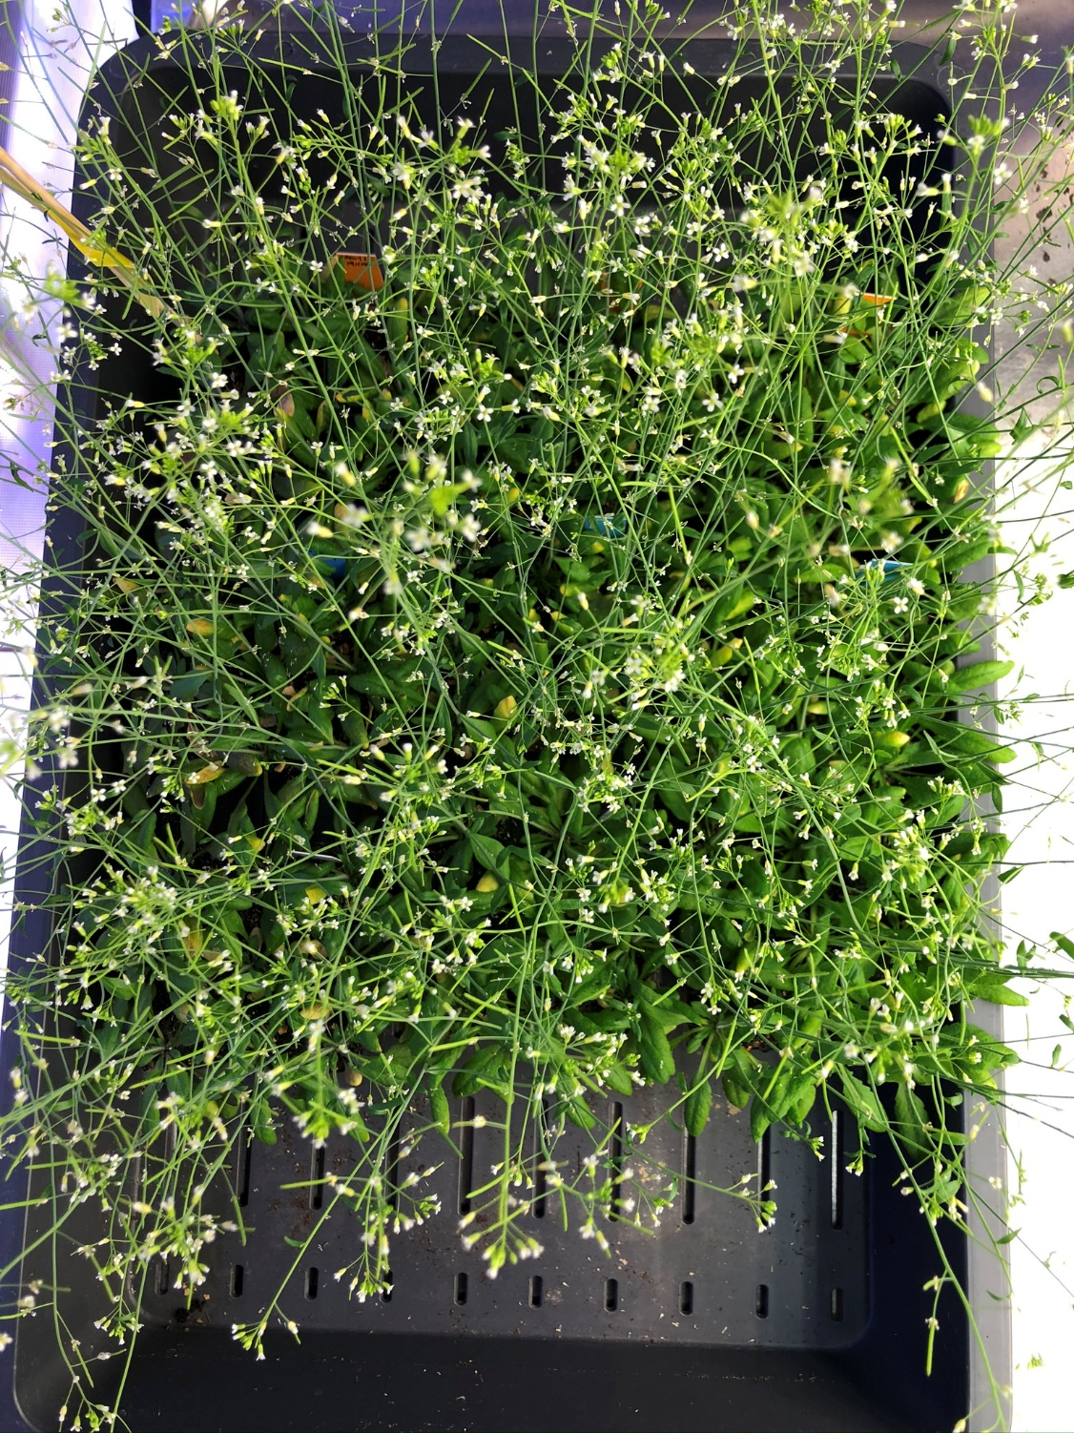
34DAS; Gramoflor no fertilizer

Slide 10
ED63 LED vs tube light chamber 20 (mixed chamber)

Slide 11
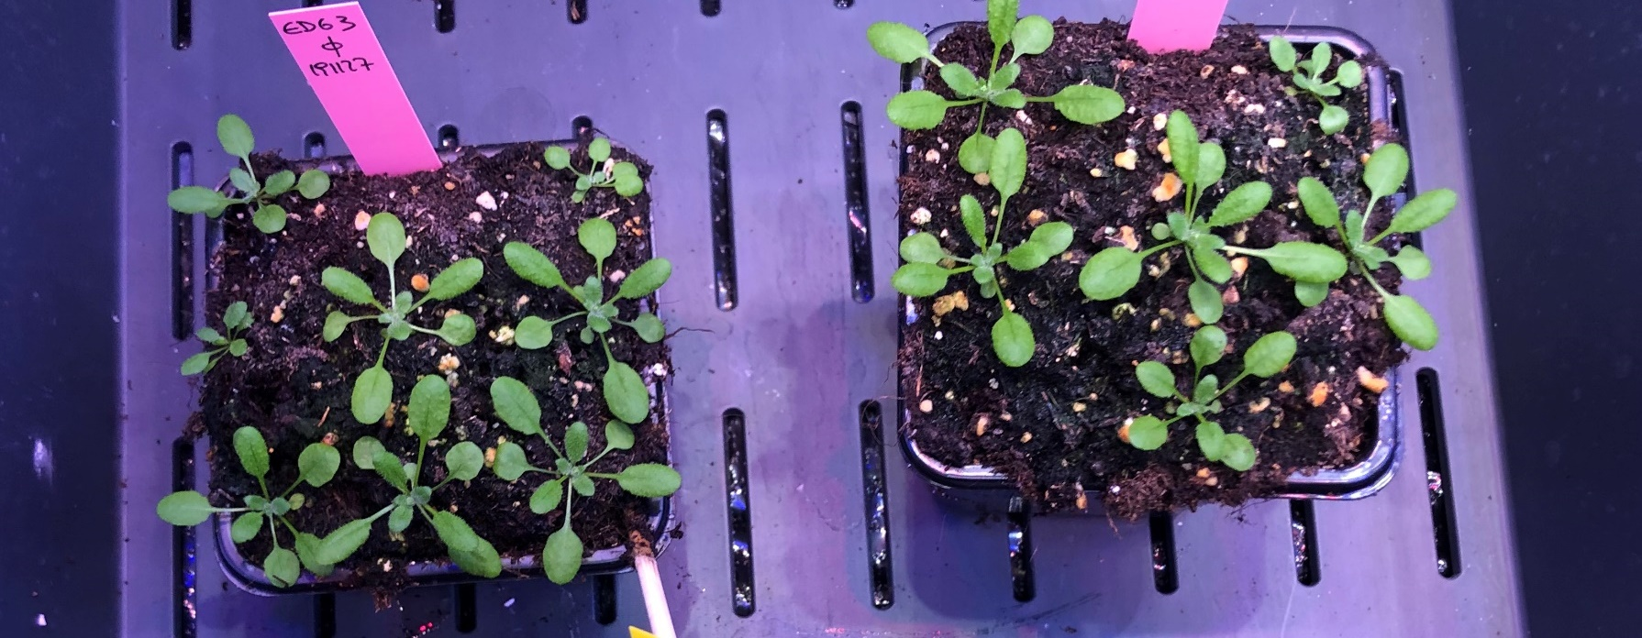
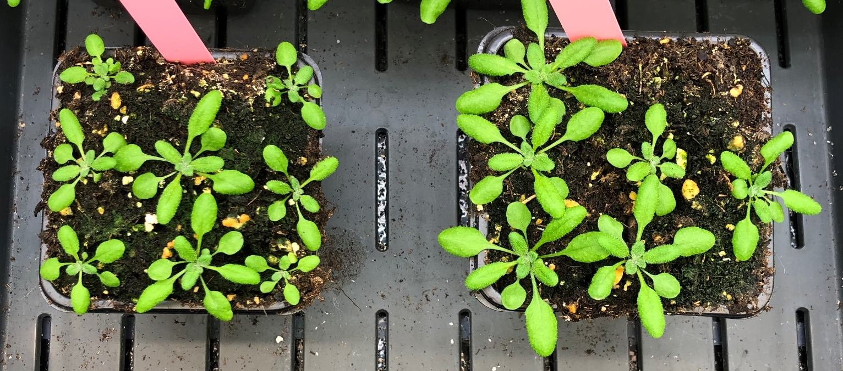
21 DAS; ED63, no fertiliter
LED
regular pot
tall pot
tubes

Slide 12
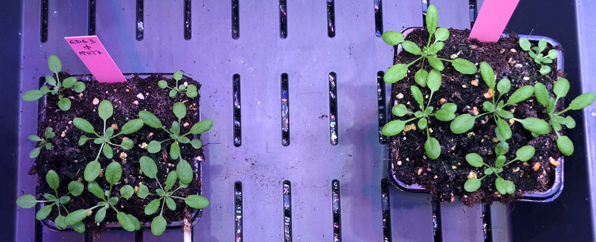
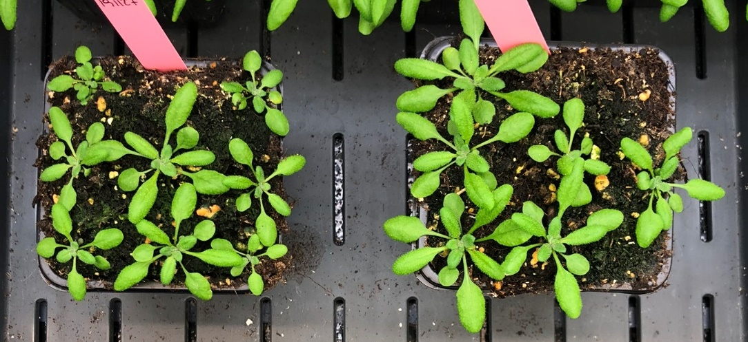
22 DAS; ED63, no fertiliter
LED
regular pot
tall pot
tubes

Slide 13
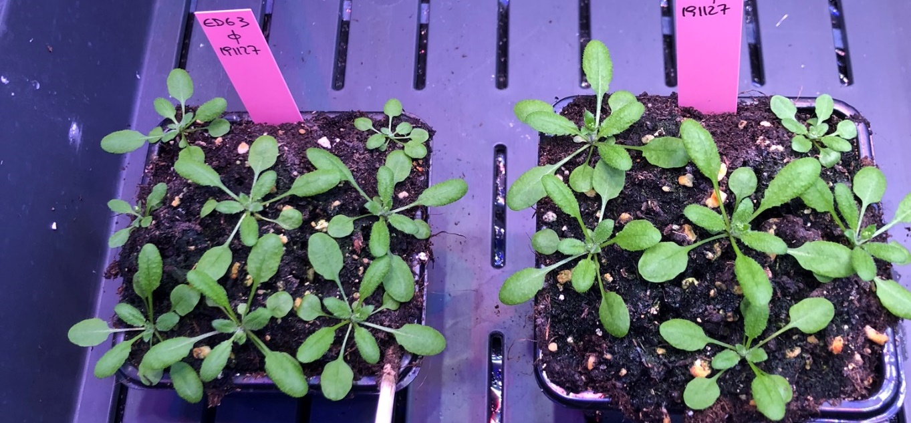
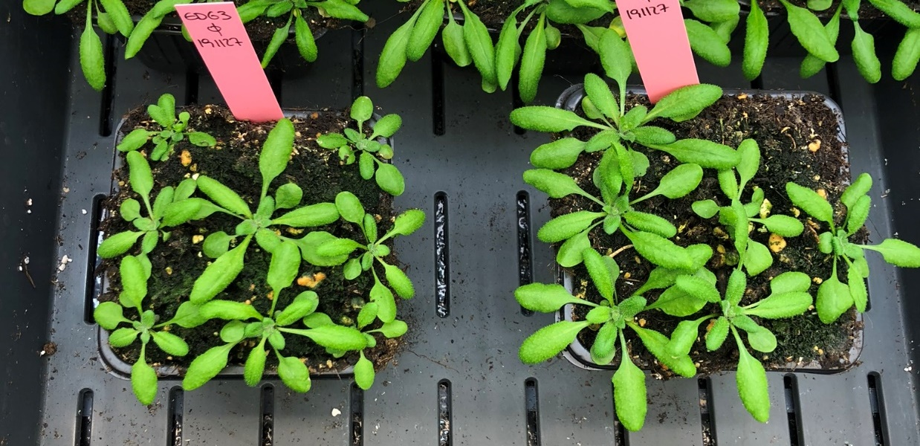
23 DAS; ED63, no fertiliter
LED
regular pot
tall pot
tubes

Slide 14
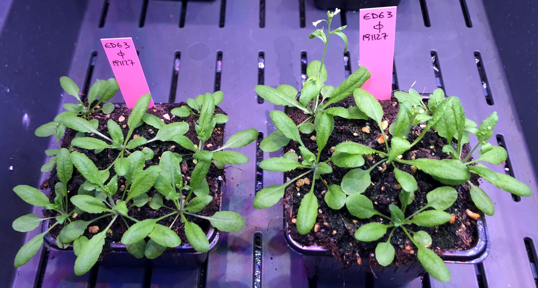
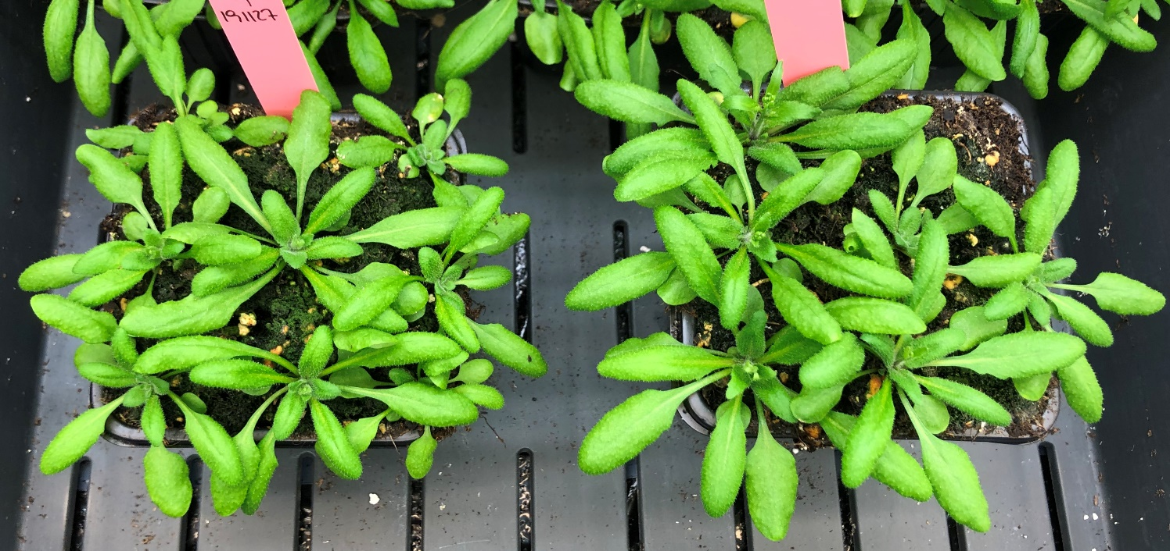
26 DAS; ED63, no fertiliter
LED
regular pot
tall pot
tubes

